Slide 1

HOLY MARY INSTITUTE OF TECHNOLOGY & SCIENCE (Approved by AICTE, New Delhi, Affiliated to JNTU, Hyderabad)
BOGARAM(V),KEESARA(M),MEDCHAL DISTRICT-501301
2021-22
DEPARTMENT OF COMPUTER SCIENCE ENGINEERING
Crime Rate Prediction
By:
Neeradi Aryan Raj (18C91A0561)
Panniru Soumya (18C91A0569)
Pingili Rakesh Reddy (18C91A0575)
Under the guidance of:
Dr.B.NARSIMHA.
Professor & Head,
Dept. of CSE

Slide 2
ABSTRACT
This project involves building a prediction system that can analyse and predict the crime rate of a particular location.
The system needs to be fed with relevant data. It uses k-means data mining algorithm to predict the crime rate.
The k-means algorithm can cluster co-offenders and organized crime groups by detecting relevant crime patterns via hidden links, link prediction ,and statistical analysis of crime data.
With the increasing advent of computerized systems, crime data analysts can help the Law enforcement officers to speed up the process of solving crimes.
Using the concept of data mining we can extract previously unknown, useful information from an unstructured data. Here we have an approach between computer science and criminal justice to develop a data mining procedure that can help solve crimes faster.

Slide 3
INTRODUCTION
Day by day crime data rate is increasing because the modern technologies and hi-tech methods helps the criminals in achieving the illegal activities .
according to Crime Record Bureau crimes like burglary, arson, murder, abuse, etc have been increased .
Data mining helps in solving the crimes faster and this technique gives good results when applied on crime dataset, the information obtained from the data mining techniques can help the police department .
We predict regions which have high probability for crime occurrence and can visualize crime prone areas. With the increasing advent of computerized systems, crime data analysts can help the Law enforcement officers to speed up the process of solving crimes.
It will also help to create a somewhat safer, crime-free neighbourhood for the citizens as they will be more aware of different types of crimes occurring .

Slide 4
.
EXISTING SYSTEM:
Crimes are documented and stored physically and they are not quick to access and read the relevant data.
It is not possible to accurately predict the crime patterns and detect crime groups with the file system.

Slide 5
Disadvantages:
Users who don’t have internet connection can’t access the system.
Admin must enter correct records otherwise system will provide wrong information.

Slide 6
PROPOSED SYSTEM:
By our project we can modify the existing system in such a way that anybody can easily understand and use our system, and it’s user friendly system.
Our system can predict regions which have high probability for crime occurrence and can visualize crime prone areas.
Using the concept machine learning we can extract previously unknown, useful information from an unstructured data.

Slide 7
Advantages :
Helps to prevent crime in society.
System will keep historical record of crime.
System is user friendly.
Saves time.

Slide 8
SOFTWARE REQUIREMENTS :
Operating system : Windows 10.
Coding Language : Python, machine learning.
Editor : VS CODE
HARDWARE REQUIREMENTS :
System : Intel i 5Core.10th gen
Hard Disk : 222 GB.
Monitor : 15.6’’ LED
Input Devices : Keyboard, Mouse
Ram : 8 GB

Slide 9
Input dataset
Data
pre-processing
Raw data
Raw data
Prepared Data
Data mining and Machine learning algorithms
Data classification
Apply Algorithms
Crime clustering
Crime prediction
Data Visualization
Crime Prediction and Crime clustering based on the input dataset

Slide 10
SYSTEM ANALSYS
Crime analysis and prediction is a systematic approach for identifying the crime. This system can predict region which have high probability for crime occurrences and visualize crime prone area. Using the concept of data mining we can extract previously unknown, useful information from an unstructured data

Slide 11
IMPLEMENTATION
Implementation of the project is done with the help of python language. To be particular, for the purpose of machine learning Anaconda is being used.
Data was scraped from the publicly available data from police website which had been made by people in police station of different areas.
Implementation of the idea started from the city itself so as to limit an area for the prediction and making it less complex.
The data was sorted and converted into a new format of timestamp, longitude, latitude, which was the input that machine would be taking so as to predict the crime rate in particular location or city.

Slide 12
SYSTEM TESTING
The purpose of testing is to get errors. Testing is that the process of trying to get
→Every conceivable fault or weakness during a work product. It provides how to see the
→Functionality of components, sub assemblies, assemblies and/or a finished product it's
→The method of exercising software with the intent of ensuring that the software meets
→Its requirements and user expectations and doesn't fail in an unacceptable manner.

Slide 13
RESULTS
The crime rates in India are increasing day by day due to many factors such as increase in poverty, implementation, corruption, etc.
The project helps the crime analysis to analysis these crime networks by means of various interactive visualization.

Slide 14
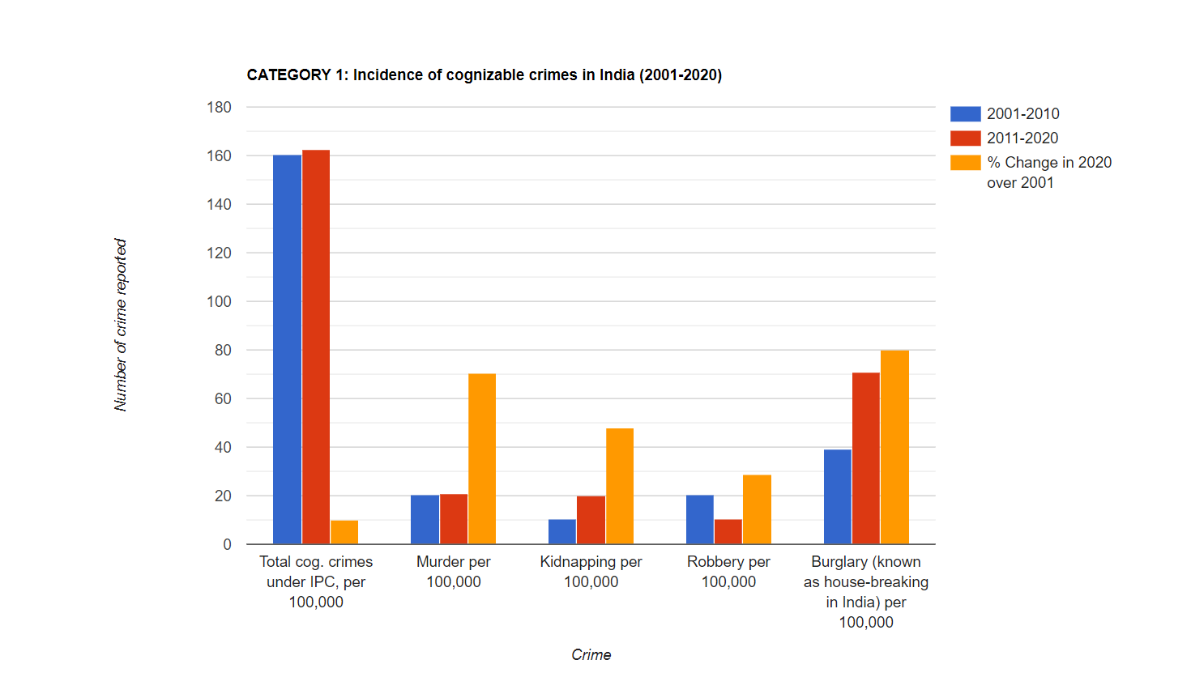
RESULTS
The crime rates in India are increasing day by day due to many factors such as increase in poverty, implementation, corruption, etc.
The project helps the crime analysis to analysis these crime networks by means of various interactive visualization.

Slide 15
FUTURE SCOPE
As a future extension of our work, we plan to apply more classification models to increase crime prediction accuracy and to enhance the overall performance.
It is also a helpful extension for over study to consider the income information for neighbourhoods in order to see if there are relationships between neighbourhood’s income level and their crime findings.
Furthermore, we want to study other crimes datasets from new cities along with their demographic’s datasets.

Slide 16
CONCLUSION
The crime rates in India are increasing day by day due to many factors such as increase in poverty, implementation, corruption, etc.
The proposed system is very useful for both the investigating agencies and the police official in taking necessary steps to reduce crime.
The project helps the crime analysis to analysis these crime networks by means of various interactive visualization.

Slide 17

2
Any Queries ?

